Slide 1
QSO 705 Capstone in Business Analytics Prevention Plays Feedback Survey Analysis
Team Members: Devika Adumala
Minakshi Chaudhary
Varun Marigandla

Slide 2
Part 1 – About Second Act Organization and Prevention Plays

Slide 3
About Second Act Organization
EVERYONE DESERVES A SECOND ACT
MISSION
2nd Act is a collective of artists in recovery which uses theatre, film, and drama therapy to address the impact of substance use. Together we empower diverse and inclusive communities to promote understanding in the face of stigma.
VISION
We believe in a world where all stories are honored, recovery is celebrated, and everyone gets a second act.
PROGRAMS
2nd Act’s educational and therapeutic interventions empower individuals and communities to take personal and social action in response to the impact of substance use. Our programs utilize theater, film and drama therapy to promote collective recovery.

Slide 4

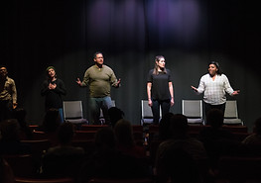
About Second Act Programs
PREVENTION PLAYS
Evidence based prevention program that utilizes live productions as a creative intervention with students. All plays are created and performed by people in recovery and meet state DOE standards in health education.

Slide 5
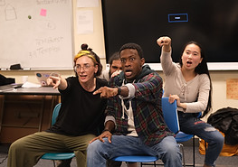
About Second Act Programs
ACT NOW!
Prevention-focused social emotional learning (SEL) curriculum taught that uses theatre techniques to teach the 5 core competencies of SEL, created and taught by a teaching artist in recovery

Slide 6
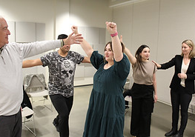
About Second Act Programs
DRAMA THERAPY
Trauma-informed therapeutic intervention to prevent relapse, compassion fatigue, and secondary trauma among Certified Peer Recovery Specialists, facilitated by a drama therapist in recovery

Slide 7
About Prevention Plays
2nd Act is the only nonprofit organization in the United States that creates original drama therapeutic productions as a substance use prevention intervention. We utilize real stories, actors with lived experience, drama therapeutic theory, and prevention framework to ensure audiences walk away with a deeper understanding of and compassion for Substance Use Disorder and those affected by it.

Slide 8
About Prevention Plays
PLAYS RUN 30-45 MIN & ARE:
Performed by actors in long-term recovery or with lived experience of Substance Use
Based on real stories
Designed to meet relevant health education standards based on Department of Education outcomes for each state where 2nd Act performs
Followed by a facilitated talkback from our actors
Suitable for ages 12 and above
Accompanied by a discussion and resource guide

Slide 9
About Prevention Plays
OUTCOMES
Identify what Substance Use Disorder (SUD) looks like in an individual and a family.
Identify the nature and origins of SUD.
Identify a trusted adult and local resources to talk to about SUD.
Normalize conversation about SUD by practicing it post-show.
Create allyship within the student body to help support those struggling with SUD.
Identify pathways to recovery and healthy coping skills.

Slide 10

About Prevention Plays
I'll Never Do That
THIS PLAY HAS BEEN ON TOUR SINCE 1989
An intimate story of one family's struggles happening behind closed doors. As one of the parents descends deeper into addiction, the rest of the family struggles to cope. This story sheds light on family dynamics, the harrowing path to recovery, and the overwhelming truth that addiction is a “family disease.”
Written by: Improbable Players

Slide 11
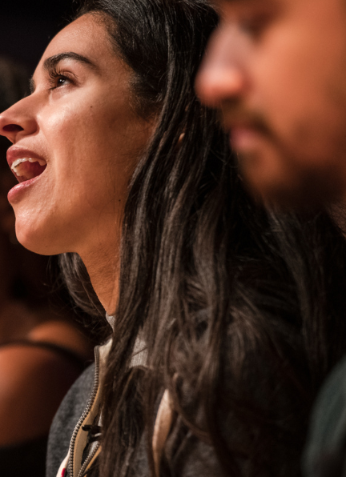
About Prevention Plays
I'll Be There for You
​I'll Be There For You follows a group of young people as they create an original play inspired by their daily lives, using the stage as a way to better understand themselves and the world around them. They pull themes from their own lived experience, such as gender and immigrant identity, relationships with adults, and the ways alcohol and other drugs can reshape the landscape of a young person's life. Ultimately, they discover what it means to write one’s own ending.
Written by: 2nd Act

Slide 12
Past Performance Venues (Alphabetical from A to D)
Northeast US (NH, VT, CT, MA, RI, NJ, NY, PA, ME) | Ohio
360 High School Addiction Referral Center and Hudson Youth Camp Arlington High School B.F. Butler Middle School Berkshire DA STRIVE Conference Bigelow Middle School Brookline High School Brookview House Chapel Hill Chauncy Hall School Conackamack Middle School Daley Middle School Delaware Valley Regional High School Dr. An Wang Middle School Duggan Middle School Dunellen High School | ADAMHS Board of Cuyahoga County Bard Early College High School (CMSD) Bay High School Berea High School + Ohio Guidestone Bolton Elementary School (CMSD) Brecksville-Broadview Heights City School District Cleveland State University CMSD Professional Development Center Community Assessment and Treatment Services Cuyahoga Community College DEA 360

Slide 13
Part 2 - Data and Data Cleaning

Slide 14
Prevention Plays – Survey Questions
Question | Short Name
What is the name the organization you're affiliated with?
What is your age range? | Age Group
What is your ethnicity? (Check any that apply)
How would you best describe your gender identity? | Gender Identity
Please rate how much you agree with the following statement: "I learned new things about Substance Use Disorder from this play." | New Learning
Please rate how much you agree with the following statement: "After watching the play, I feel like I can identify at least 2 resources for myself or a loved one related to substance use and/or harm reduction." | Identify Resources
Did this play change your opinion on Substance Use Disorder and its impact in your community and/or your personal life? | Change Opinion
What was your favorite part of the program? | Favorite Part
If I want to continue this conversation, I know who to talk to. | Continue Conversation
Do you have any additional feedback?

Slide 15
Question: What is your age range?
Age Group | Count | Age Group | Count
Age 10-13 | 576 | Age 10-13 | 773
Ages 10-13 | 197
Age 10-14 | 289 | Age 10-14 | 289
Age 14-18 | 217 | Age 14-18 | 309
Ages 14-18 | 92
Age 19 and older | 3 | Age 19 and older | 40
Age 19+ | 7
Age 19-30 | 1
Age 19-64 | 2
Ages 22 + | 1
Age 31-50 | 8
Age 51-70 | 12
Age 71 and older | 6
Prefer not to say | 4 | Prefer not to say | 4
Grand Total | 1415 | Grand Total | 1415
Combined 15 different Age Groups to 5 Age Groups

Slide 16
Question: What is your ethnicity? (Check any that apply)
Ethnicity | Count | Ethnicity | Count
Other | 249 | Caucasian, Other | 2
Caucasian | 194 | Hispanic/ Latino, East Asian | 2
Asian/ Pacific Islander | 154 | Hispanic/ Latino, Caribbean | 2
South Asian | 136 | South Asian, Mixed Ethnicity | 1
Latino/Hispanic | 132 | South Asian, African | 1
White/Caucasian | 108 | Caucasian, South Asian, Mixed Ethnicity | 1
East Asian | 86 | Caucasian, East Asian, Mixed Ethnicity | 1
Mixed | 59 | South Asian, East Asian, African | 1
Multi-race | 52 | Hispanic/ Latino, South Asian, East Asian, Middle Eastern | 1
South Asian, East Asian | 43 | Caucasian, South Asian, East Asian | 1
Hispanic/ Latino | 40 | East Asian, Mixed Ethnicity | 1
African | 39 | Caucasian, South Asian | 1
Black/African American | 27 | East Asian, Other | 1
Middle Eastern | 21 | Hispanic/ Latino, East Asian, Caribbean, Mixed Ethnicity | 1
Mixed Ethnicity | 20 | African, Other | 1
Caribbean | 11 | Hispanic/ Latino, Middle Eastern | 1
Caucasian, Hispanic/ Latino | 3 | Hispanic/ Latino, African | 1
Mixed Ethnicity, Other | 3 | South Asian, Other | 1
Hispanic/ Latino, South Asian | 3 | Caucasian, Mixed Ethnicity | 1
South Asian, East Asian, Mixed Ethnicity | 2 | (blank) | 1
Hispanic/ Latino, Mixed Ethnicity | 2 | Hispanic/ Latino, African, Caribbean, Mixed Ethnicity | 1
African, Mixed Ethnicity | 2 | American Indian/ Alaskan Native | 1
Hispanic/ Latino, African, Caribbean | 2 | Grand Total | 1415
46 different types of ethnicities.
Plotted the top 15 that were at least 1% of the responses (20 or more responses).

Slide 17
Question: How would you best describe your gender identity?
Gender Identity | Count | Gender Identity | Count
Cisgender male/man/boy | 602 | Cisgender male/man/boy | 602
Cisgender female/woman/girl | 590 | Cisgender female/woman/girl | 590
Other/ Prefer not to identify | 62 | Other/Prefer not to identify | 115
Other/Prefer not to identify | 53
Genderqueer, gender non-binary and/or gender fluid | 67 | Genderqueer, gender non-binary and/or gender fluid | 67
Transgender male/man/boy | 32 | Transgender male/man/boy | 32
Transgender female/woman/girl | 7 | Transgender female/woman/girl | 7
(blank) | 2 | No Response | 2
Grand Total | 1415 | Grand Total | 1415
Combined 8 types of gender identities into 7 gender identities.

Slide 18
Question: What was your favorite part of the program?
Favorite Part | Count | Favorite Part | Count
The play | 1053 | The play | 1053
Hearing personal stories from actors that have lived experience with substance use or identify as a person that is in long term recovery | 148 | Hearing personal stories from actors that have lived experience with substance use or identify as a person that is in long term recovery | 150
the actors sharing their personal stories and how they achieved sobriety | 1
The actors | 1
The Talkback/Question and Answer Forum with Actors | 156 | The Talkback/Question and Answer Forum with Actors | 174
The Talkback/ Question and Answer Forum with Actors | 18
Other | 23 | Something else | 38
Something else | 15
Grand Total | 1415 | Grand Total | 1415
Combined 8 Categories into four categories.

Slide 19
Question: Please rate how much you agree with the following statement: "I learned new things about Substance Use Disorder from this play."
New Learning | Count | New Learning | Count
5 - Strongly agree | 137 | 5 - Strongly agree | 300
5 | 163
4 - Agree | 407 | 4 - Agree | 660
4 | 253
3 - Neither agree nor disagree | 130 | 3 - Neither agree nor disagree | 326
3 | 196
2 - Disagree | 28 | 2 - Disagree | 69
2 | 41
1 - Strongly disagree | 33 | 1 - Strongly disagree | 60
1 | 27
Grand Total | 1415 | Grand Total | 1415
Combined 10 categories into 5 categories.

Slide 20
Question: Please rate how much you agree with the following statement: "After watching the play, I feel like I can identify at least 2 resources for myself or a loved one related to substance use and/or harm reduction."
Identify Resources | Count | Identify Resources | Count
5 - Strongly agree | 133 | 5 - Strongly agree | 287
5 | 154
4 - Agree | 351 | 4 - Agree | 558
4 | 207
3 - Neither agree nor disagree | 165 | 3 - Neither agree nor disagree | 385
3 | 220
2 - Disagree | 49 | 2 - Disagree | 112
2 | 63
1 - Strongly disagree | 37 | 1 - Strongly disagree | 73
1 | 36
Grand Total | 1415 | Grand Total | 1415
Combined ten categories into 5 categories.

Slide 21
Question: If I want to continue this conversation, I know who to talk to.
Continue Conversation | Count | Continue Conversation | Count
5 - Strongly agree | 126 | 5 - Strongly agree | 190
5 | 64
4 - Agree | 382 | 4 - Agree | 455
4 | 73
3 - Neither agree nor disagree | 162 | 3 - Neither agree nor disagree | 274
3 | 112
2 - Disagree | 32 | 2 - Disagree | 62
2 | 30
1 - Strongly disagree | 33 | 1 - Strongly disagree | 50
1 | 17
(blank) | 384 | No Response | 384
Grand Total | 1415 | Grand Total | 1415
Combined 11 categories into 6 categories

Slide 22
Did this play change your opinion on Substance Use Disorder and its impact in your community and/or your personal life?
3 categories – no change was made
Change Opinion | Count
No | 281
Somewhat | 672
Yes | 462
Grand Total | 1415

Slide 23
Part 3 - Analysis of Feedback Responses to Various Questions

Slide 24
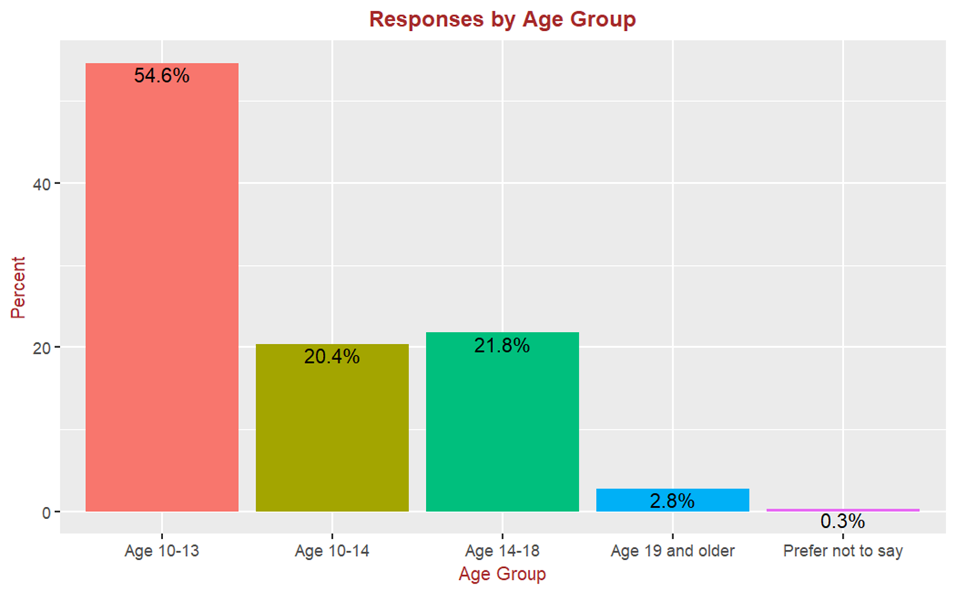
Responses by Age Group
Most of the responses (54.6%) Were from age group 10-13 followed by 21.8% from age group 14- 18 and 20.4% group 10-14.
Only 2.8% of the responses were from age group 19 and older and 0.3% Preferred no to provide their age.

Slide 25
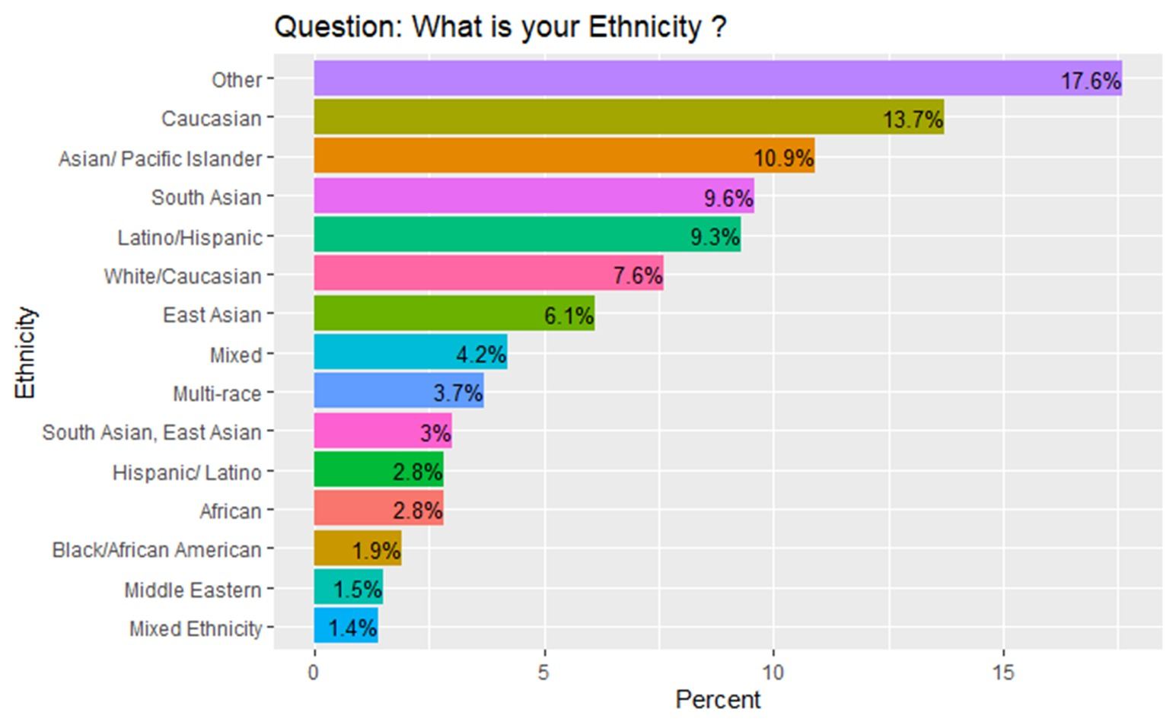
Responses by Ethnicities
This chart includes ethnicity categories that are more than 1% of all responses.
17.6% of the respondent's belong to the other category.
Of the remaining 13.7% are Caucasian followed by Asian/Pacific Islander of 10.9%
The remaining categories range between 1.4% and 9.6%

Slide 26
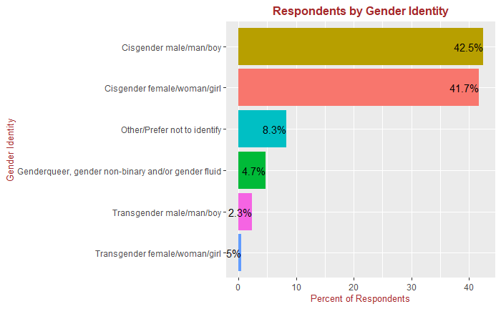
Responses by Gender Identity
The Largest groups in this data are Cisgender male/boy (42.5%) and Cisgender female/Woman/girl(41.7%).which together makes nearly 80% of the respondents. This indicates a relatively high number of cisgender individuals among the respondents.
8.3% of respondents identified as Other or preferred no to disclose their gender. Smaller groups are identified as Genderqueer, gender non -binary, and/or gender fluid(4.7%). Transgender male/man/boy (2.3%), and Transgender female/woman/girl (5%), reflecting diversity in gender identities among respondents.

Slide 27
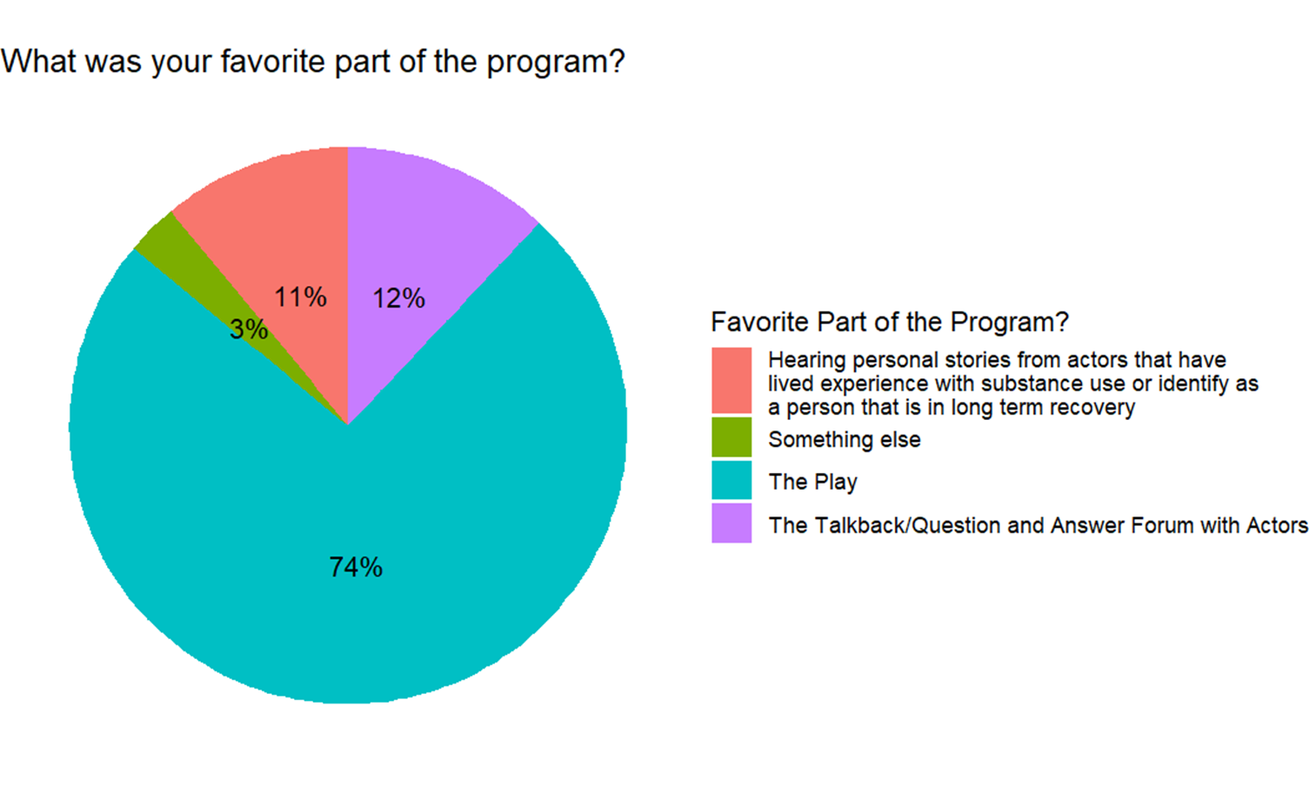
Responses by Favorite Part
For 74% of the respondents, the play itself was the favorite part of the progress.
For 12% of the respondents the talk back/question and answer forum with actors was the favorite part.
For 11% of the respondents hearing personal stories from actors was the favorite part.
.For remaining 3% of the respondents something else was the favorite part of the program.

Slide 28
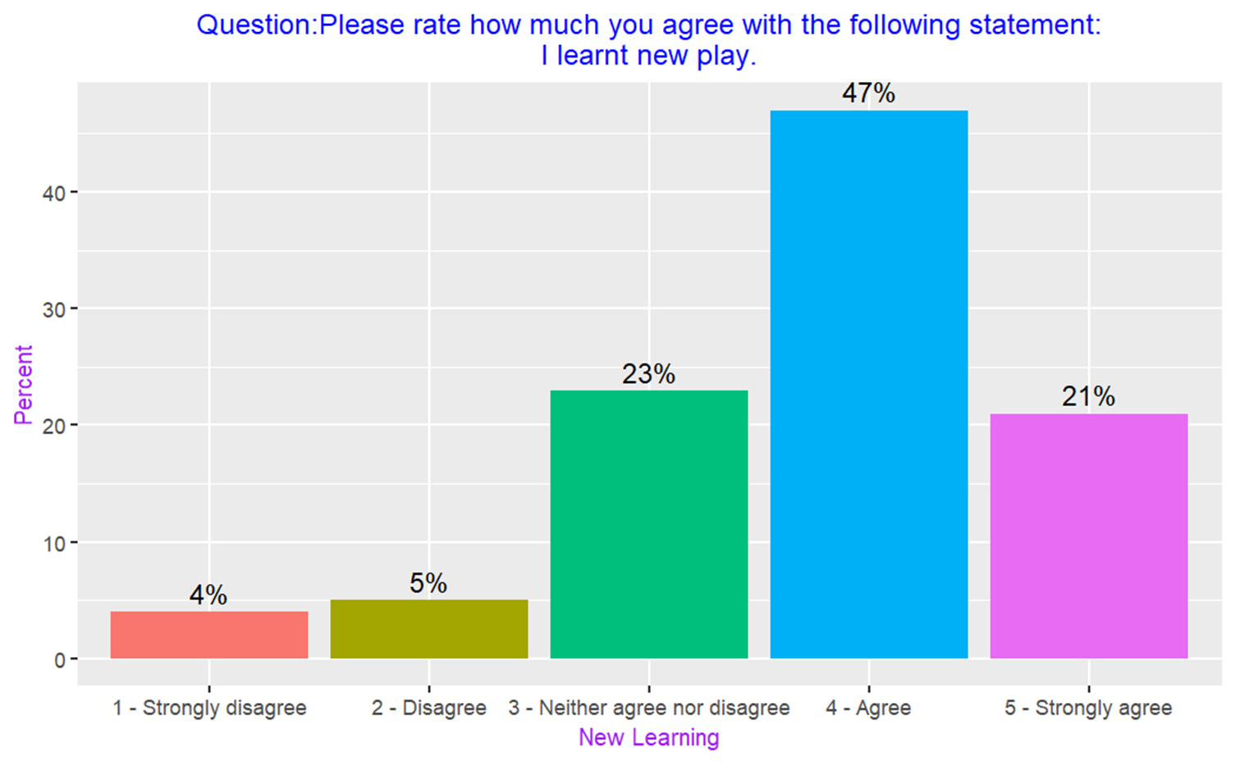
Responses by New Learning
47% of the respondents agreed with the question and 21% strongly agreed.
Only 9% either disagreed or strongly disagreed with the question.
23% of the respondents neither agreed nor disagreed

Slide 29
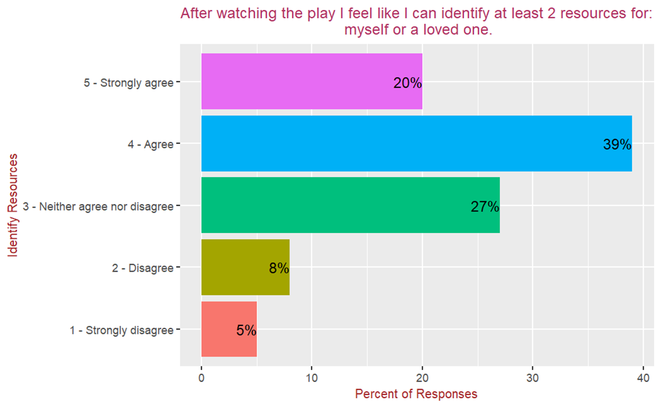
Responses by Identify Resources
Agree (39%) and Strongly Agree (20%).A combined total of 59% of respondents feel they can identify at least two resources after watching the play.
27% of respondents are neutral on this statement.
Disagree (8%) and Strongly Disagree (5%): Only 13% of respondents do not feel they can identify resources.

Slide 30
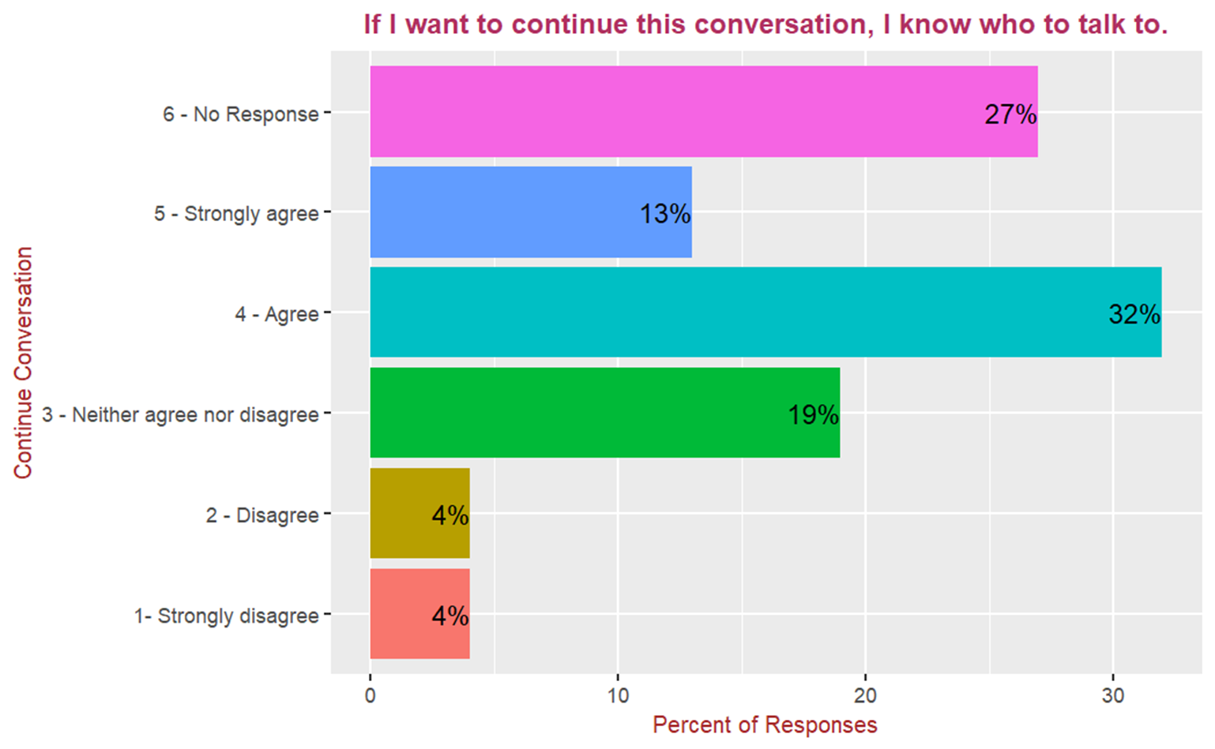
Responses by Continue Conversation
The majority of respondents (32%) agreed that they know who to talk to if they want to continue the conversation
A substantial portion of respondents (19%) neither agreed nor disagreed.
Only 4% of respondents strongly disagreed, and another 4% disagreed, indicating that very few individuals feel completely unsupported or unclear about whom to talk to.

Slide 31
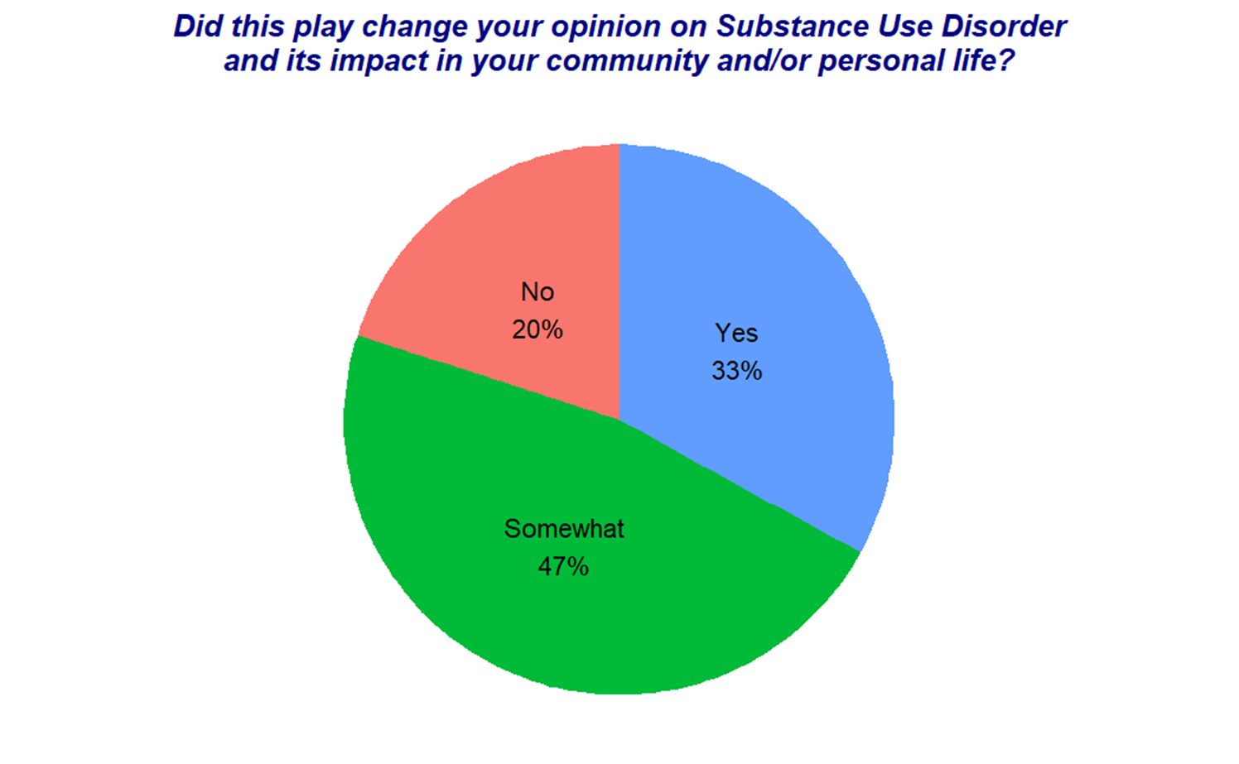
Responses by Change Opinion
33% of the respondents have changed their opinion after watching the play
47% of the respondents somewhat changed their opinion.
20% of the respondents said that their opinion did not change after watching the play.

Slide 32
Conclusions
1.Engagement with Younger Audiences:
The program successfully reached and engaged its primary audience, with the majority of responses coming from individuals aged 10-13. Efforts to expand participation among older teens and adults could broaden its impact.
2. Diverse but Imbalanced Ethnic Representation:
The program attracted a diverse audience, but significant representation gaps remain for smaller ethnic groups. Focused outreach and culturally tailored engagement strategies could help improve inclusivity.
3. Strong Positive Impact of the Play:
The play was the most impactful element, resonating with 74% of respondents and leading to opinion changes in 80% of participants. This underscores the play's effectiveness as a central feature of the program.
4. High Cisgender Representation in Gender Identity:
While nearly 16% of respondents identify outside the cisgender spectrum, the majority (84.2%) are cisgender individuals. This indicates a need for further inclusivity and representation of non-cisgender identities.
5. Most respondents (68%) expressed agreement or strong agreement with the question posed, reflecting overall alignment with the program's objectives. Only a small percentage (9%) expressed disagreement, indicating minimal resistance.
The program is impactful and resonates well with its core audience, especially through the play. However, there are opportunities for improvement in expanding age diversity, increasing inclusivity among ethnic and gender identity groups, and ensuring all participants feel supported to engage further after the program. These steps can enhance the program's reach and long-term impact.

Slide 33
Recommendations
Expand Age Reach:
Target Older Audiences: Create targeted content or separate programs for teens aged 14-18 and adults, possibly by integrating more mature themes or discussions that resonate with these groups.
Enhance Ethnic Inclusivity:
Outreach Campaigns: Develop partnerships with community organizations that serve underrepresented ethnic groups.
Foster Gender Diversity and Inclusivity:
Inclusive Content: Ensure the program and materials are explicitly inclusive of all gender identities, showcasing diverse experiences and perspectives.
Leverage the Play's Success:
Interactive Elements: Add interactive components to the play, such as audience participation or small-group discussions, to deepen engagement.
Enhance Post-Program Support:
Clear Resources: Provide participants with tangible takeaways, such as brochures, guides, or access to online platforms, detailing where they can continue the conversation.
Address Neutral and Resistant Respondents:
Follow-Up Surveys: Reach out to neutral and resistant respondents to understand their perspectives and adjust future programming accordingly.

Slide 34
Any Questions?

Slide 35
Part 4 - Analysis of Feedback Responses by Age Group

Slide 36
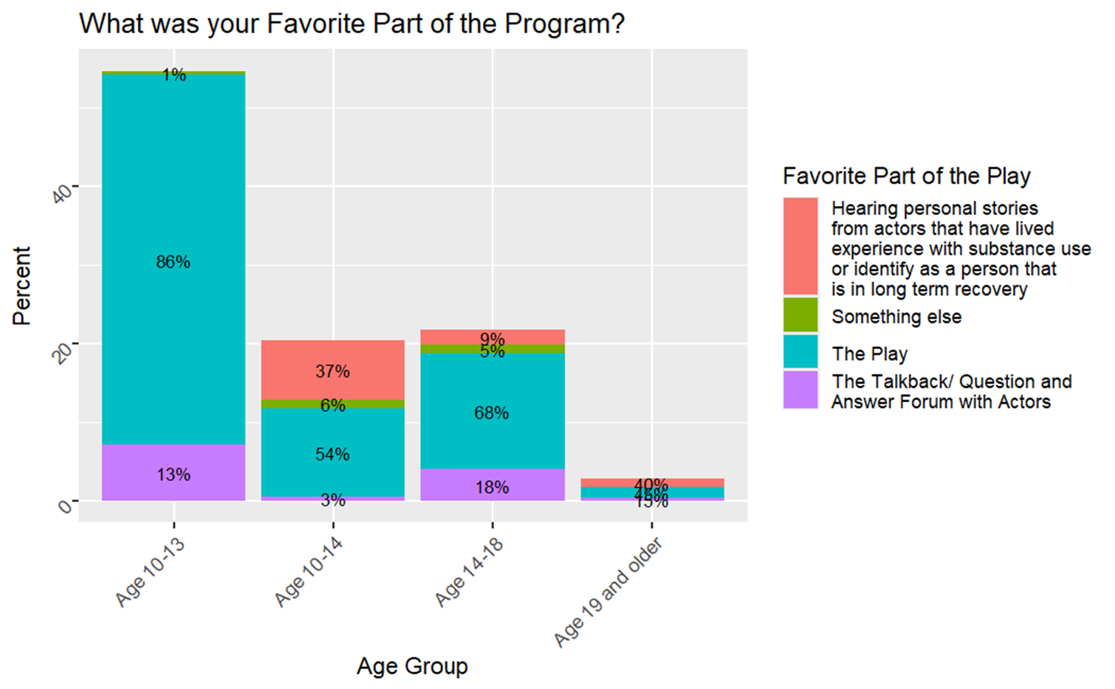
Favorite Part by Age Group
In the Age Group 10-13, 86% chose play as their favorite part Compared 68% in the Age 14-18, 54% in the 10-14 and 45% in the Age 19 and older.
Hearing personal Stories was chosen as the favorite part by 37% in the Age 10-14 by 40% in the 19 and older group and by 9% in Age 14-18. No one in the Age 10-13 chose this as their favorite part.
The talk-back/question and answer was selected by 18% in the Age 14-18 by 15% in 19 and older group.by 13% in the Age 10-13,and 3% in the age 10-14.

Slide 37
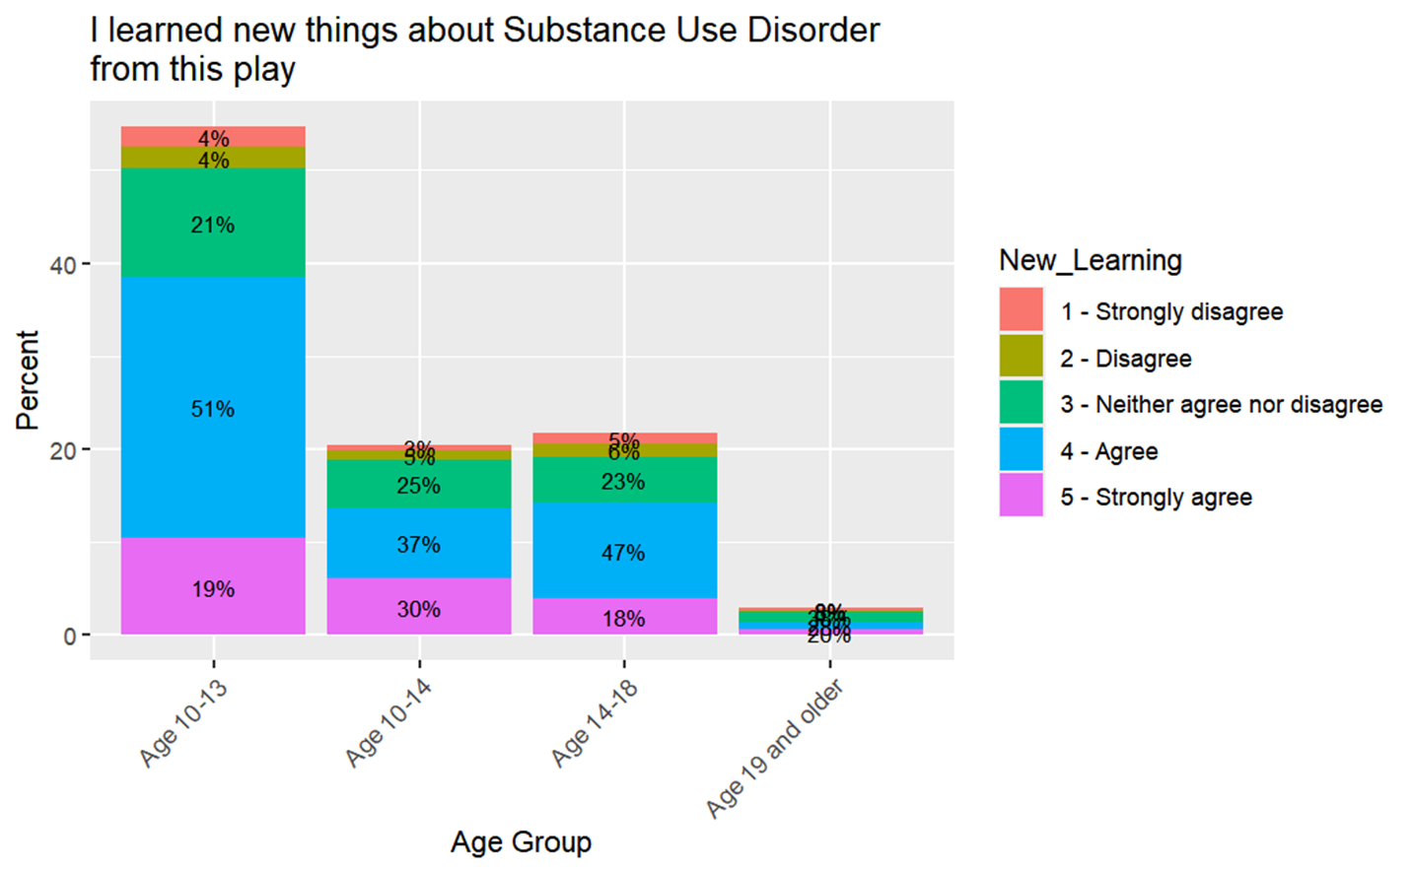
New Learning by Age Group
In the Age group 10-13, 51% selected this category and learned new thing regrading the substance use disorder compared to 47% in the Age 14-18, 37% in the Age 10-14 and 28% in the Age 19 and older.
30% Strongly agreed in the Age 10-14 selected as the new learner whereas the 20% in the Age 19 and older, 19% in the Age 10-13 and 18% in the Age 14-18.
38% respondents Neither agree nor disagree in Age 19 and older, 25% in the Age 10-14, 23% in Age 14-18 and 21% in the Age 10-13.
16% respond either strongly disagree or disagree in the age 19 and older, 11% age 14-18 and 8% in the both age 10-13 and 10-14.

Slide 38
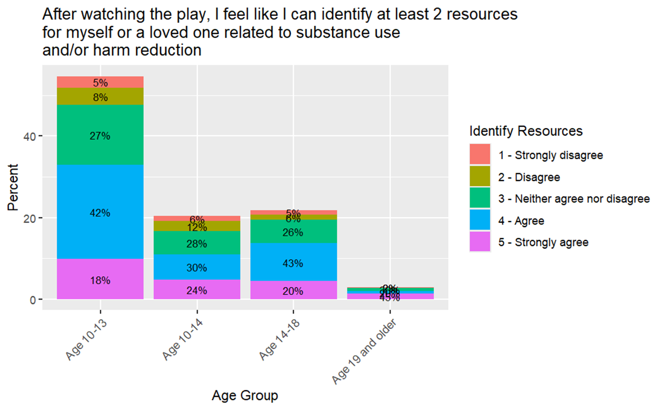
Identify Resources by Age Group
45% strongly Agree in age 19 and older and play effectively identify resources for substance use and harm reduction compared to age 10-14 25% strongly agree, age 14-18 20% strongly agree and age 10-13 18% strongly agree.
In the age 14-18, 43% respond agree, age 10-13 42% agree, age 10-14 30% respond agree and 20% in the age 19 and older.
30% respond Neither agree nor disagree in age 19 and older, 28% in age 10-14, 27% in age 10-13 and 26% in the age 14-18.
18% respond either strongly disagree or disagree in age 10-14, 13% in age 10-13, 11% in age 14-18 and 4% in 19 and older.

Slide 39
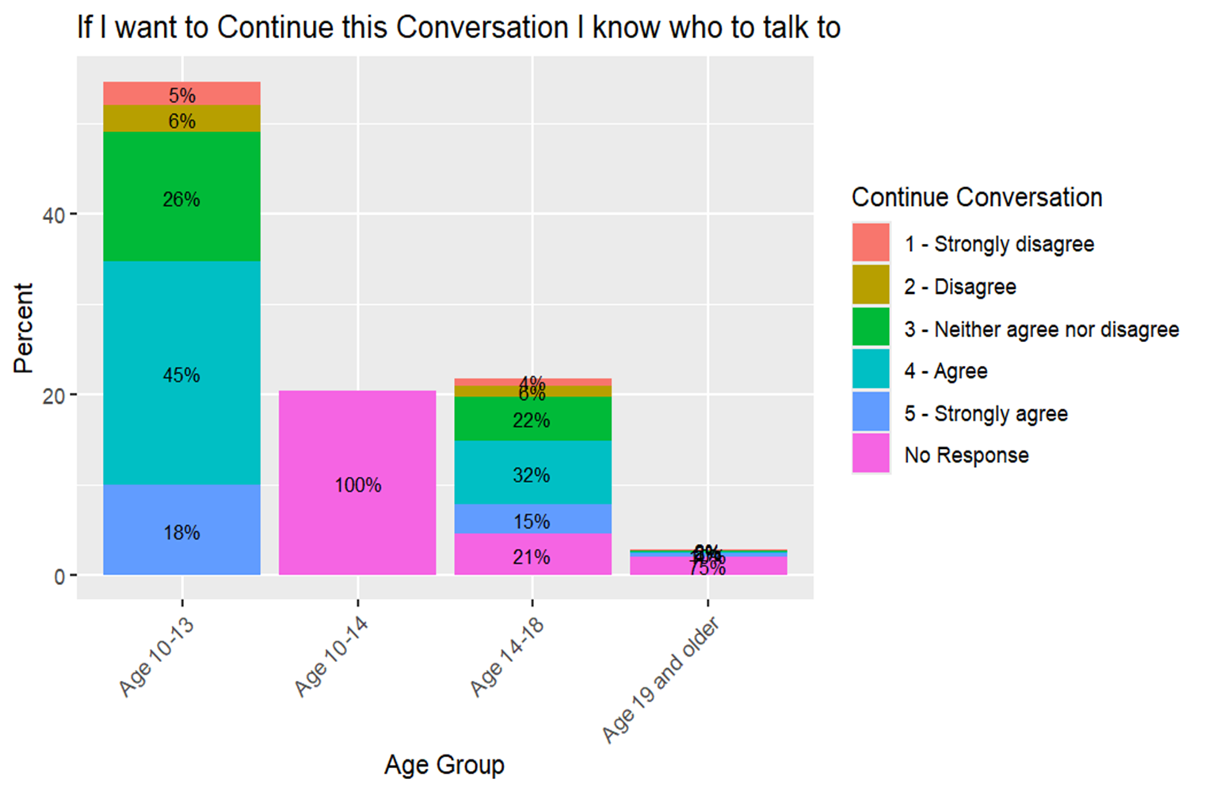
Continue Conversation by Age Group
No one in the age group 10-14 responded to this question and 75% in the 19 and older group did not respond and 21% in the age 14-18 did not respond.
In the age group,10-13, 18% strongly agreed, age 15% strongly agreed and age 19 and older 10% strongly agreed.
45% in the age group 10-13 agreed.32%in the gage 14-18 agreed. And 8% in the 19 and older group agreed.
11% in the age 10-13 either disagreed or strongly diagreed.10% in the age group 14-18 and no one in the 19 and older age group disagreed or strongly disagreed.

Slide 40
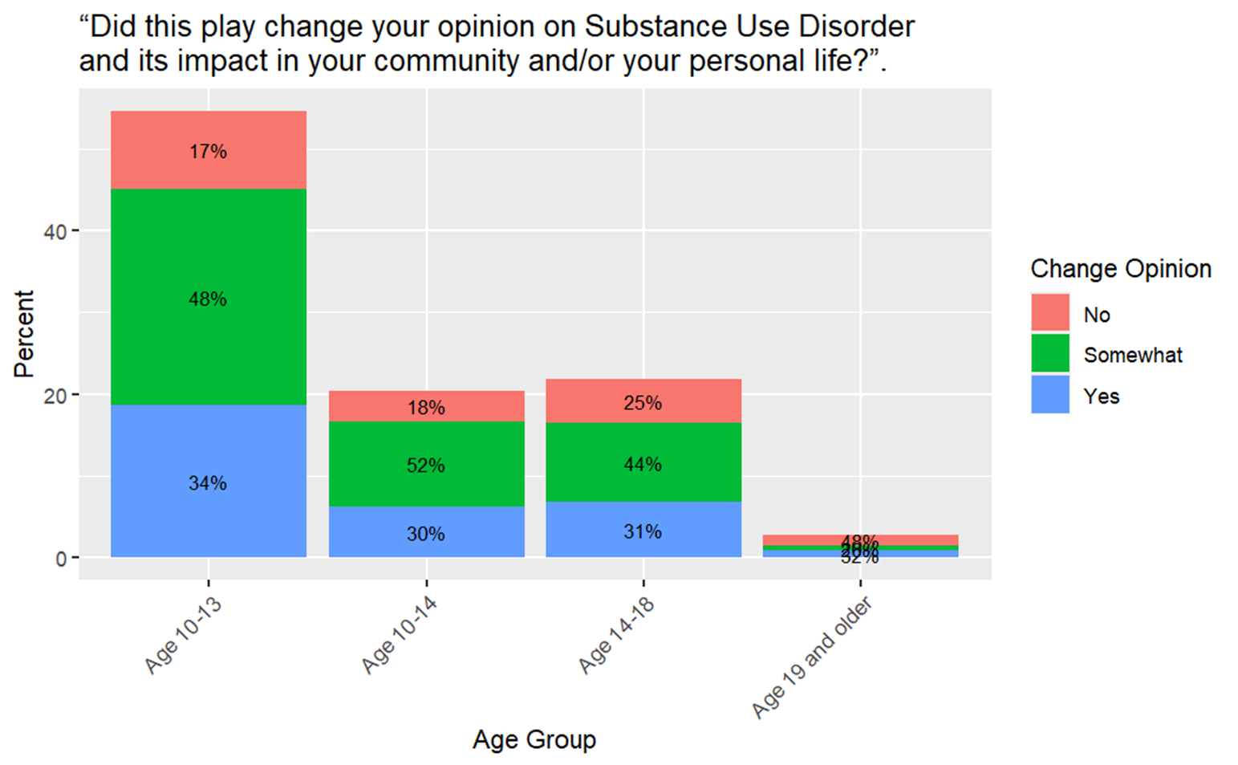
Change Opinion by Age Group
In the Age 10-13, 34% respondents Yes selected as the significant play on impact changing opinion regrading the substance use compared to 32% in the Age group Age 19 and older, 31% in the Age 14-18 and 30% in the Age 10-14.
48% in the age group 19 and older respondents No, 25% in the age 14-18 respondents No, 18% in the age 10-14 respondents No and 17% in the Age 10-13 respondents No.
In the Age, 10-14, 52% Somewhat, age 10-13 48% Somewhat, age 14-18 44% Somewhat and Age 19 and older 20%.

Slide 41
Conclusions
Activity Preferences: Different age groups have distinct preferences for activities. Younger groups (10-13) prefer play-based activities, while older groups (19+) lean towards personal stories. This shows that engaging different age groups requires catering to their unique interests.
Learning Outcomes: Younger participants (10-13 and 14-18) learned more about substance use disorders compared to older age groups, particularly those aged 19 and older. This indicates that younger people may be more receptive to learning in this context.
Impact on Opinions: The program had a stronger effect on changing opinions about substance use in younger age groups. This suggests that younger participants are more likely to be influenced by the program's content and activities.
Engagement Levels: Older participants showed less engagement and had higher non-responsiveness to certain aspects of the program. This could point to a need for more relatable or tailored content for older audiences.
Disagreement or Neutrality: Disagreement or neutrality was higher in older participants, suggesting that they may not find the program as engaging or effective as younger participants do. This highlights the need for better engagement strategies for older groups.

Slide 42
Recommendations
Tailor Activities by Age Group:
Use interactive play for younger participants (10-13) who engage most with it. Incorporate personal stories for older groups (19+) to resonate with their preferences.
Focus on Learning Impact:
Enhance learning activities for older participants, as their reported learning is significantly lower than younger groups.
Improve Engagement:
Reduce non-responsiveness among older participants by introducing relatable content and encouraging active participation.
Provide Targeted Educational Materials:
Create age-specific materials to simplify complex topics and improve retention for all age groups.
Monitor and Evaluate:
Collect feedback regularly to assess the effectiveness of activities and make necessary improvements for better results.

Slide 43
Any Questions?

Slide 44
Part 5 - Analysis of Feedback Responses by Gender Identity

Slide 45
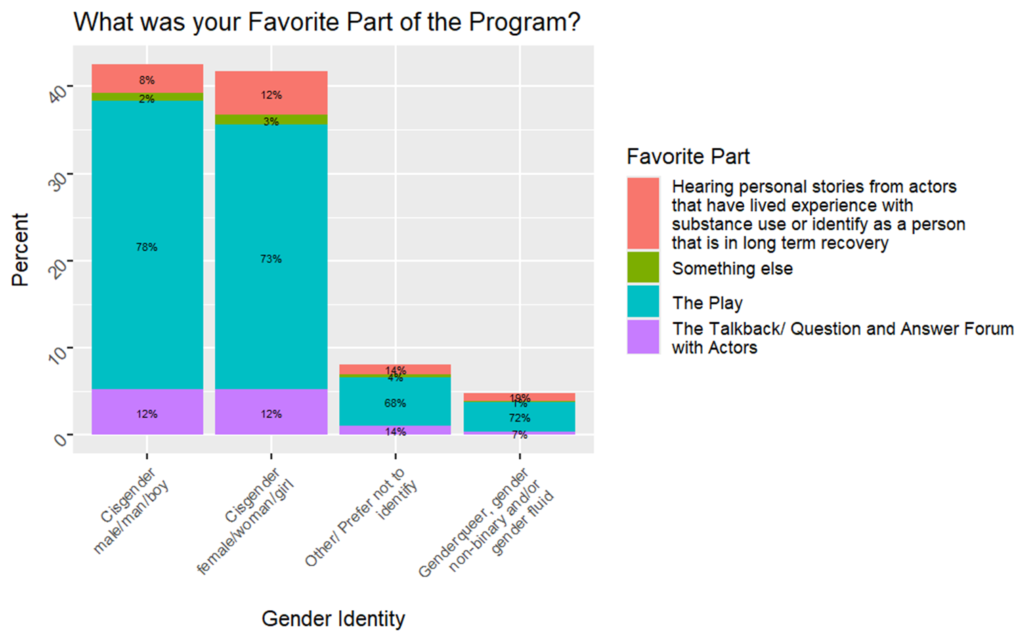
Favorite Part by Gender Identity
The play itself was the favorite part for 78% of the males,73% of the females,68% for those who did not respond and 72% of the queer gender.
Talkback/question and answer was the favorite part for 12% for the females.14% for those who did not disclose their gender identify and !% for the queer gender.
Hearing personal stories was the favorite part for 8% of the males.12% for females, 14% for those who did not disclose their identify and 1% of the queer gender.

Slide 46
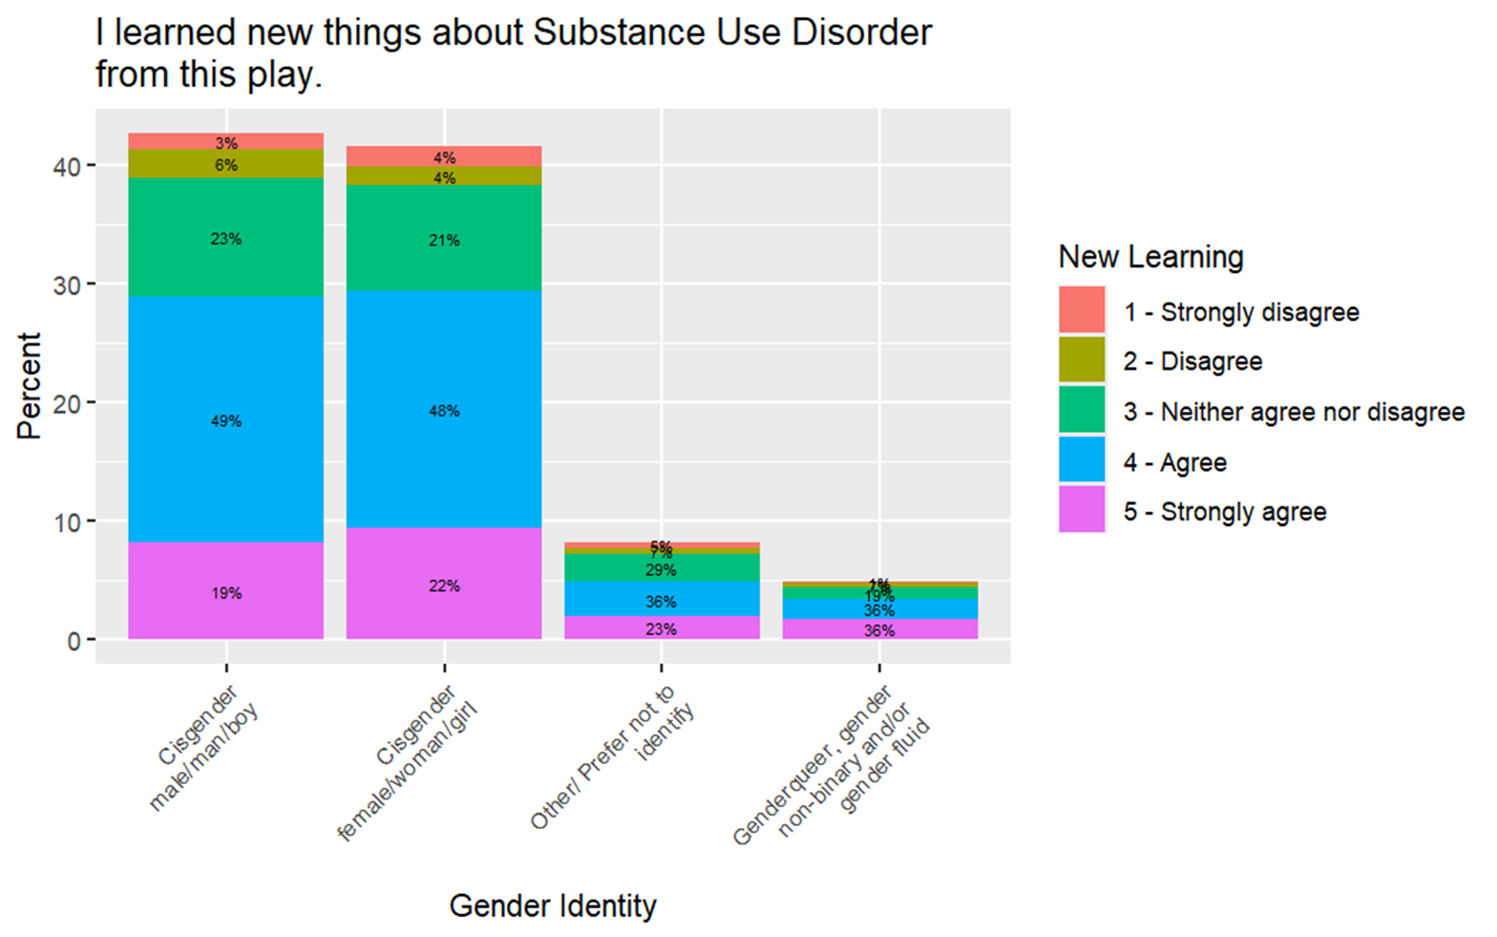
New Learning by Gender Identity
49% respondent Agreed by Cisgender male for new learning about Substance use disorder compared to 48% in cisgender female, 36% represent both others and Gender queer.
The neither agree nor disagree respondents 29% by other/prefer not to identity, 23% in cisgender male, 21% in cisgender female and 19% in Genderqueer.
Strongly Agree was the new learning in Genderqueer, 23% for other/prefer not to identity, 22% of Cisgender female and 19% for the Cisgender male.

Slide 47
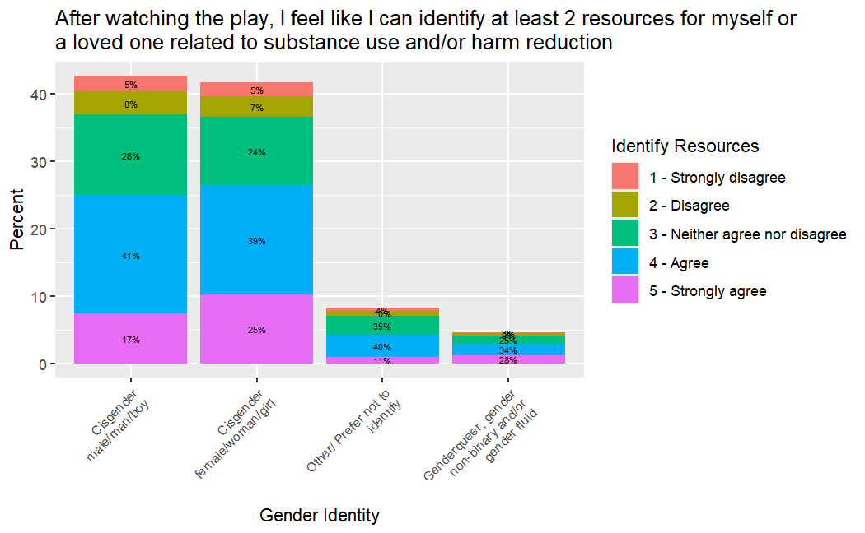
Identify Resources by Gender Identity
The Agree identifying resources regarding the substance use for 41% of the Cisgender male, 40% for other, 28% of Gender queer and 25% in Cisgender female.
Neither Agree nor disagree was the favorite play for 35%% for others, 28% for male, 25% for genderqueer and 24%in Disagree.
Strongly agree was the favorite play for 28% of Genderqueer, 25% of female, 17% for male and 11% in others.

Slide 48
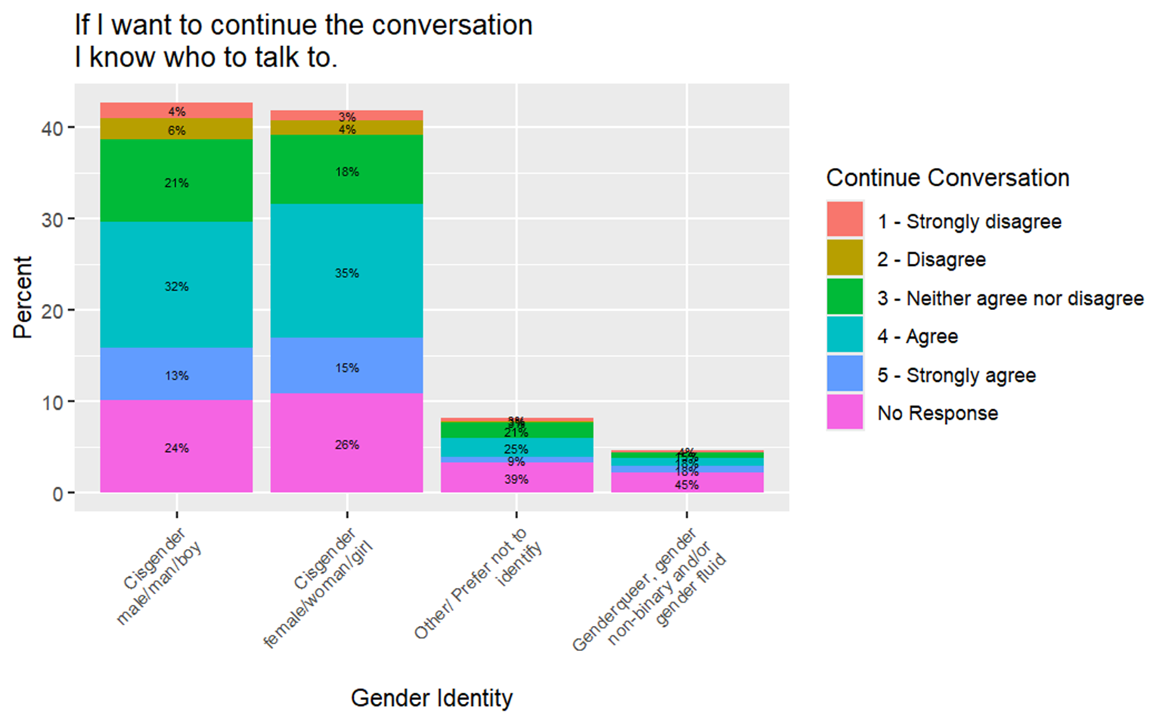
Continue Conversation by Gender Identity
The Agree continue the conversation of the substance use for 35% of the Cisgender female, 32%% for Male, 25% of other and 18% in Gender queer.
No response, 45% by Gender queer, 39% for other, 26% for Cisgender female and 24% of Cisgender male.
Neither agree nor disagree for continue conversation, 21% by both Cisgender male and others, 18% responds by both category Cisgender female and Genderqueer.
Strongly Agree response, 18% for Genderqueer, 15% for Cisgender female, 24% for Cisgender male and 9% of other.

Slide 49
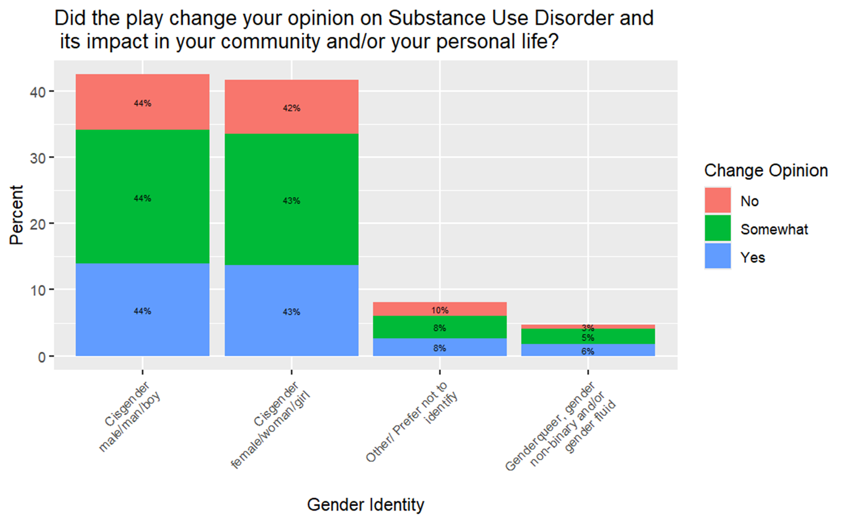
Change Opinion by Gender Identity
Both Cisgender male/man/boy and female /woman/girl where 44-43% response Yes which change opinion on Substance Use Disorder compared to 8% others/prefer not to identity and 6% Genderqueer, gender non-binary.
44% commented No by Cisgender/male, 41% by Cisgender female, 10% by others and 3% in Genderqueer, gender non-binary.
44% respondent Somewhat in Cisgender male/man, 43% in Cisgender/female/woman, 10% in other and 3% in Genderqueer, gender non-binary.

Slide 50
Conclusions
The play was the favorite component for the majority, with over 70% of respondents across most groups ranking it as their top choice. This suggests that the play is an effective medium for delivering impactful messages on substance use disorders.
Activities such as talkback sessions and personal storytelling resonated far less with participants, especially among queer gender respondents. These components need improvement in terms of structure and relatability to broaden their appeal.
Cisgender males and females demonstrated higher levels of agreement regarding new learning about SUD (48–49%). However, only 36% of "others" and genderqueer respondents agreed, highlighting a gap in effectiveness for these groups.
A majority of cisgender participants (64% female and 58% male) felt confident identifying at least two resources related to substance use or harm reduction. However, neutrality (24–28%) and disagreement (12–13%) among others suggest a need for better resource communication.

Slide 51
Recommendations
Enhance Engagement with the Play
Since the play was overwhelmingly the favorite part for all gender groups, continue using it as the central component of programming.
Improve Talkback and Q&A Sessions
With low preference (12–14%) for these sessions, consider redesigning the format to be more engaging
Tailor Resources for Learning about Substance Use Disorder (SUD)
While cisgender males and females largely agree they gained new knowledge, fewer genderqueer and "prefer not to disclose" respondents report the same.
Promote Resource Awareness and Usage
Provide detailed, actionable resource guides during and after events.

Slide 52
Any Questions

